Slide 1
Waste Sustainability Training
Improving waste diversion at UCSF Health

Slide 2
Introductions
Contact Information:
Email: HealthSustainability@UCSF.edu
Website: http://tiny.ucsf.edu/UCSFHealthWaste
Contact with questions, ideas, or to become a green champion

Slide 3
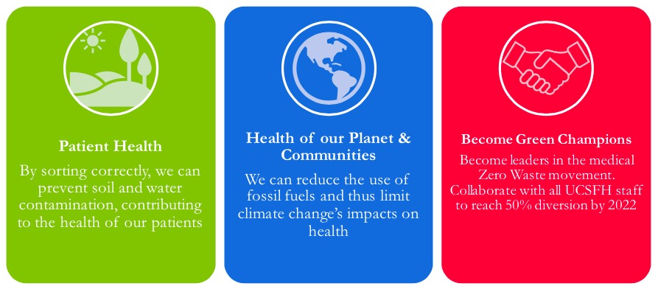
Why Compost & Recycle?
2025
Notes:
-at 30% right now

Slide 4



San Francisco Refuse Separation Ordinance​
Effective July 1, 2019​
Fines for contamination​
Contamination limits (if exceeded, load will be landfilled, and site will be fined):​
≤5% for Compost. ≤10% for Recycle ≤25% for Landfill​
​
Notes:
-if a batch is over the limit, the whole batch is sent to the landfill

Slide 5
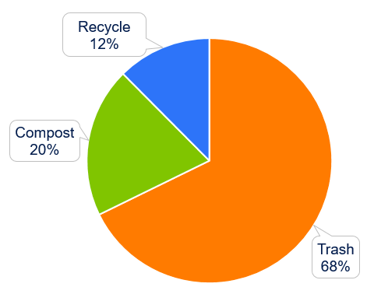
What’s in the Trash?
After conducting waste audits at the three campuses, we discovered:​
12% of trash could be recycled​
20% of trash could be composted​
By sorting correctly, we can divert an additional 9,000 lbs. of waste every day!​
Notes:
With the systems we already have in place

Slide 6
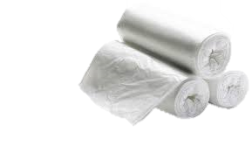
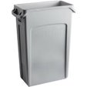

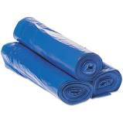
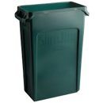
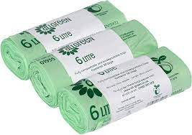
Standard Bin Colors & Location
Trash
Color: Gray bin, clear liner, no lid
Color: Blue bin, blue liner, no lid
Recycle
Color: Green bin, compostable green liner, lid optional.
Compost
Location: Breakroom, Restroom, Exam Rooms, Team Work Areas
Location: Breakroom or Team Work Areas
Location (paper towels): Bathroom
Location (food waste): Breakroom
Extra bin requests must be put into MCSS
You can also request bins through us, at healthsustainability@ucsf.edu !
Notes:
Add pictures of lids

Slide 7
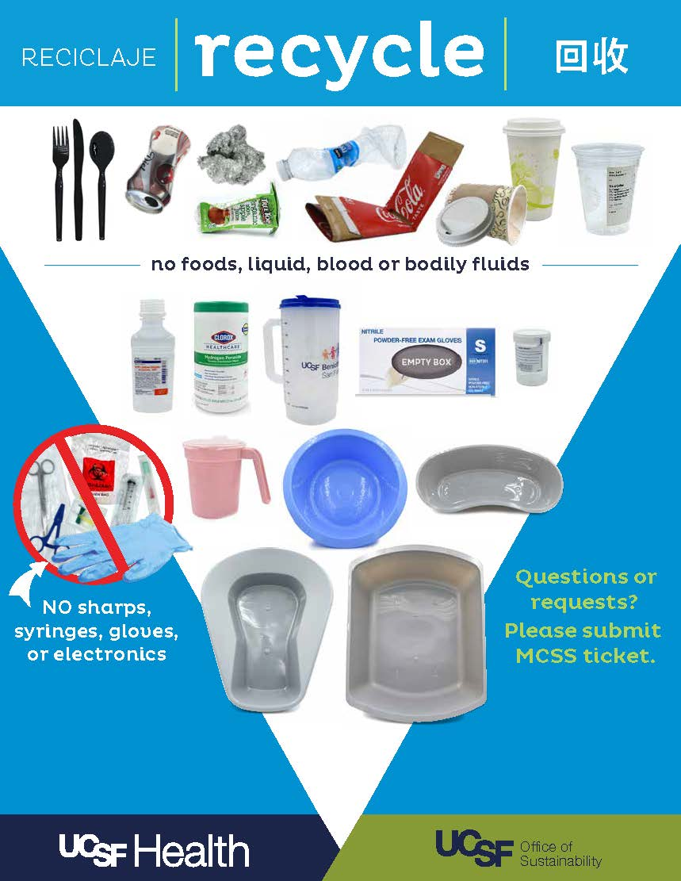
Recycle
Okay: metal/glass bottles & cans, hard plastics, cardboard & clean paper
Not Okay (contaminants): Food (including food soiled paper plates), liquids, body fluids, paper towels, plastic film, PPE
*if there are no recycling bins around, recyclables should go in the landfill, not the compost

Slide 8
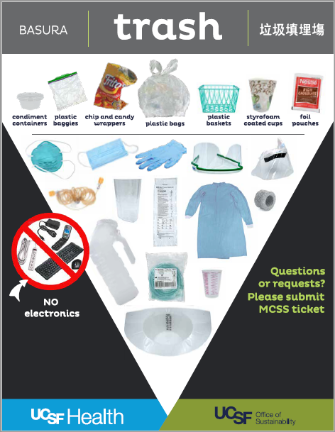
Landfill
Okay: PPE, Soft plastics, Styrofoam, snack wrappers, most packaging
Not Okay: universal, pharmaceutical, PHI, hazardous, biohazardous, etc.), e-waste
Monthly e-waste events or UCSF logistics website for disposal
Battery disposal guide on the EHS website

Slide 9
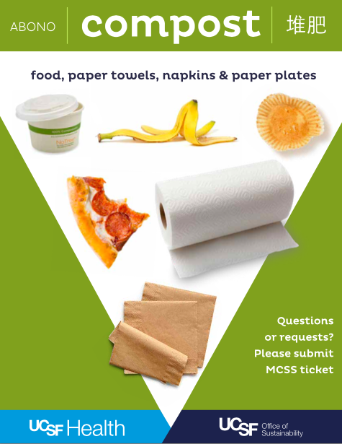
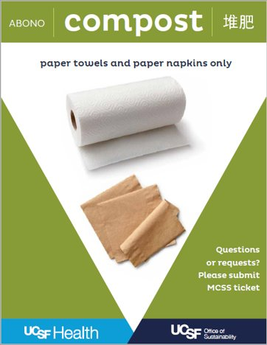
Compost
Okay: Food, paper towels, napkins, food soiled paper products, compostable containers
*if there are no compost bins, compostable material should go in the landfill not the recycling
Compostable and recyclable material in patient rooms can be left on patient food trays, and will be sorted by kitchen staff

Slide 10
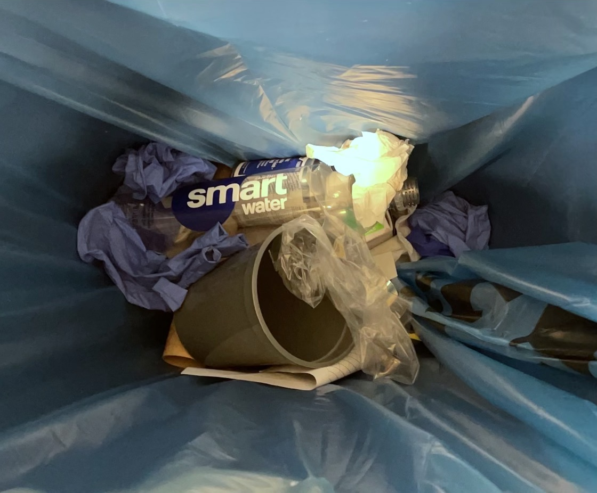
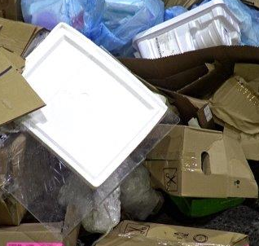
Contamination (in recycling)
Paper Towels
COMPOST
Styrofoam
Gloves/PPE & Soft Plastic
TRASH

Slide 11
Audits and Unit Report Cards
Audits
Monthly waste audits are performed at in-patient units to track how UCSF Health is doing in terms of waste sustainability
Self-audits can be performed by unit staff using the self-audit sheet on the UCSF Health Waste website
Unit report cards
Created from the audits to track your units progress
Should be shared with unit staff to encourage improvements

Slide 12
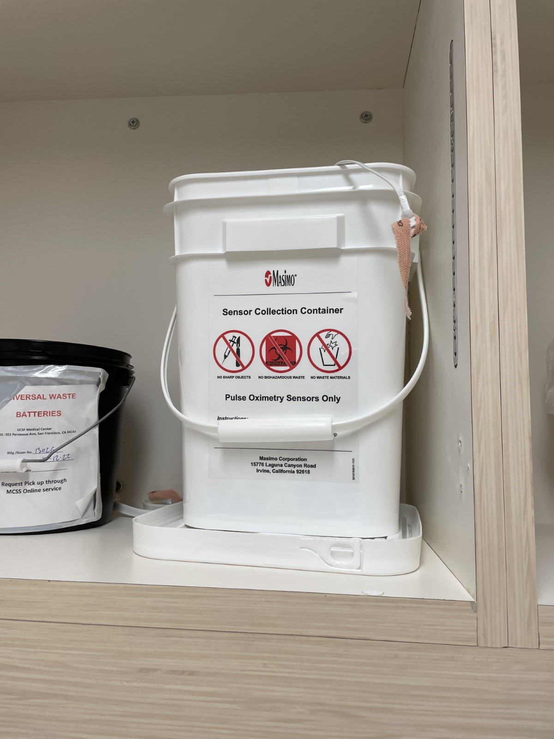
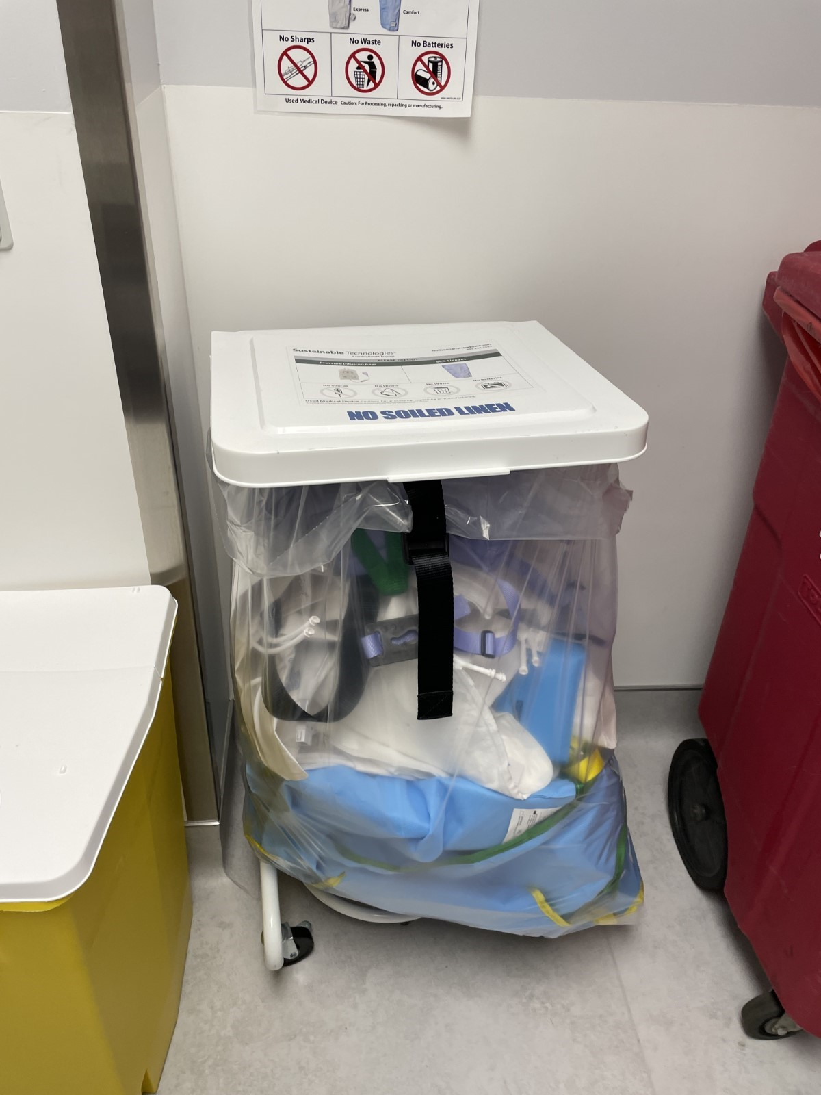
The Power of Reprocessing: Dirty Utility Rooms
Hovermatts/slings
SCD Sleeves & Infusion Bags
Pulse Oximetry Sensors

Slide 13
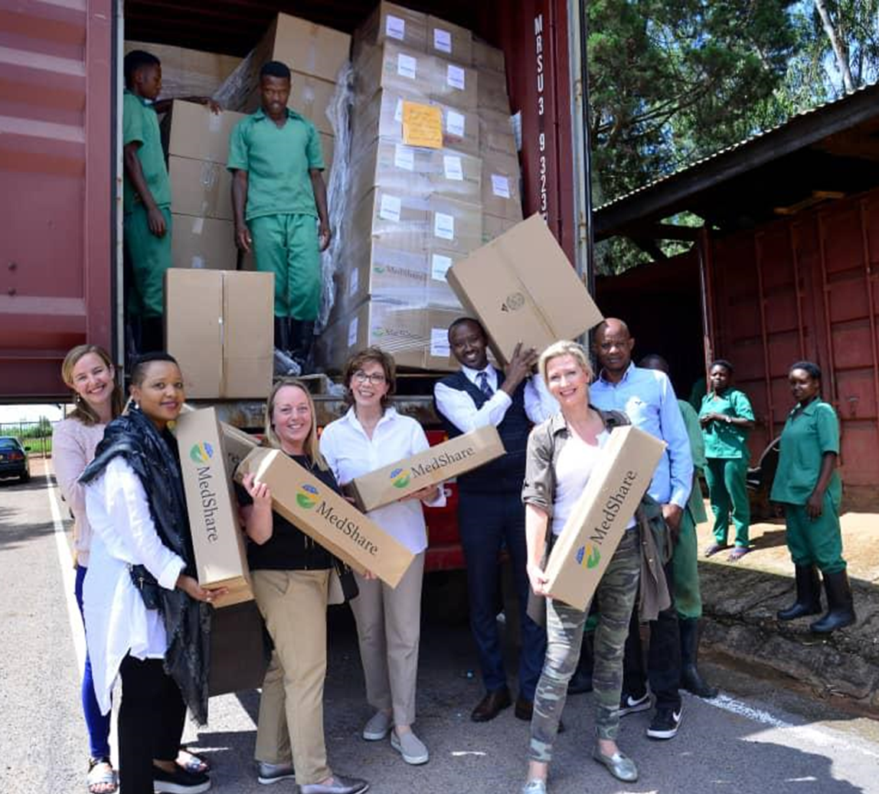
Donations Program
UCSF Health has recently relaunched the Medical Supply Donations Program for excess supplies!
Accepts unopened, unused, and unexpired products

Slide 14
Learning Center Training
The Office of Sustainability has a 15 minute online quiz version of this training
Consists of the training slides and a sorting quiz

Slide 15
Questions?

